Slide 1


A Seminar on
By
Suhas Mane

Slide 2


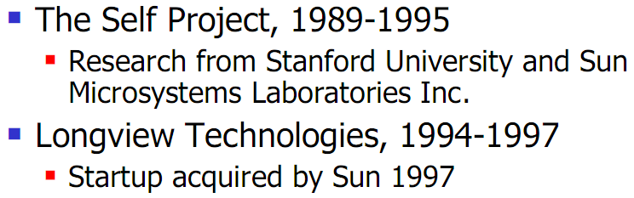
Dynamic Compilation
Original Developer of Hot Spot

Slide 3
HotSpot
First Released : April 27, 1999
Initially : add-on for 1.2
Become default for 1.3
Why the name “Hot Spot” ?

Slide 4

JDK, JRE & JVM ?
JRE = JVM + std. class libraries + ..
JVM = JIT + ..
javac.exe – compiler (.java .class)
java.exe – java application launcher (JRE)
(bytecode native code)

Slide 5
Java Runtime Environment
launches runtime
environment
JRE
.java
Class loader
javac.exe
Bytecode verifier
java.exe
interpreter
JIT
.class
Loads from hard disk,
Network or other source
runtime
Hardware

Slide 6
Bytecode Verifier & sandBox
This step is making java virus proof.
untrusted code / any java code
Branches : to valid locations?
Data : initialised?
References : type safe?
Bytecode verifier
JVM

Slide 7
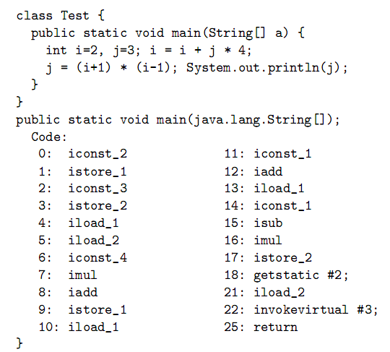
Bytecode ?
Why the name “bytecode” ?

Slide 8
Support for other languages..
Ruby
JavaScript
Groovy
Scala
Python
Clojure
JVM
C code
machine language
C to bytecode compiler
JVM

Slide 9
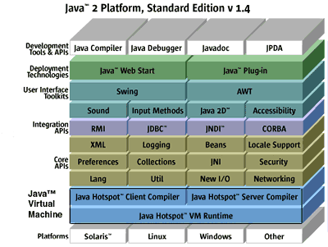

Slide 10
The HotSpot VM :-
HotSpot – dynamic compiler.
What is dynamic compiler ?
Java HotSpot Client VM.
Java HotSpot Server VM.
JDK download
JRE download
-client / -server
-client
-server

Slide 11
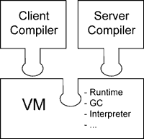
The HotSpot VM :-
Classic VM
Client VM
JIT Compiler

Slide 12
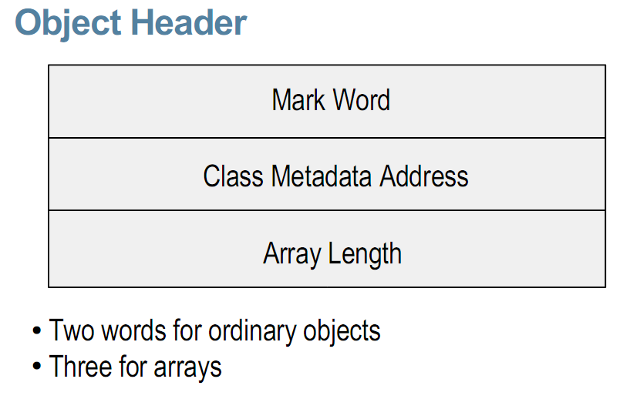
Memory Model
Handleless Objects.
Two Word Object Headers.
Reflective Data are represented as Objects.
Native Thread Support.

Slide 13
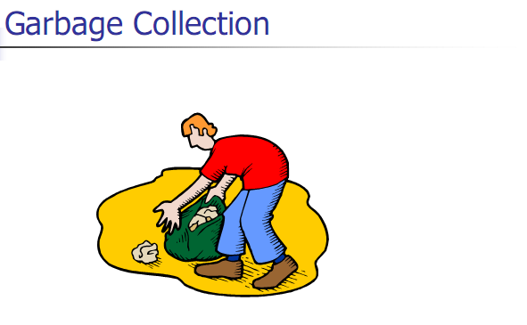
Need of
Explicit memory
management.
Dangling references.
Memory leaks.
Garbage collection
time.

Slide 14
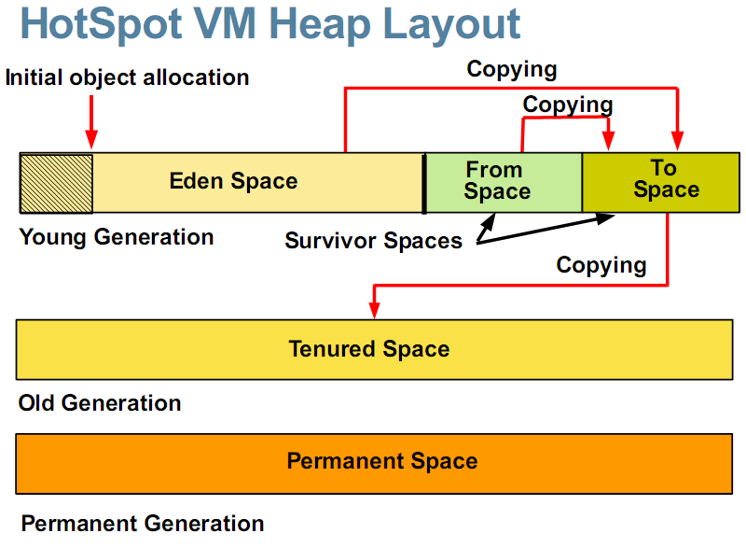

Slide 15
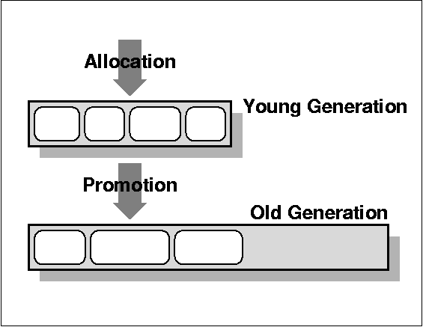
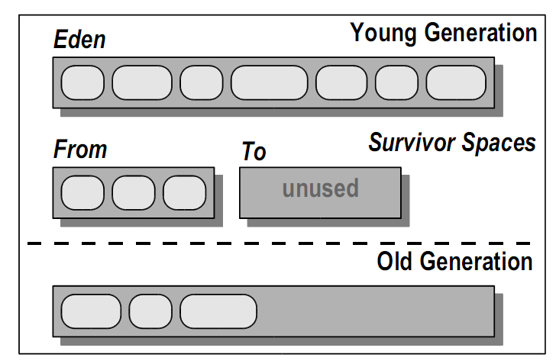
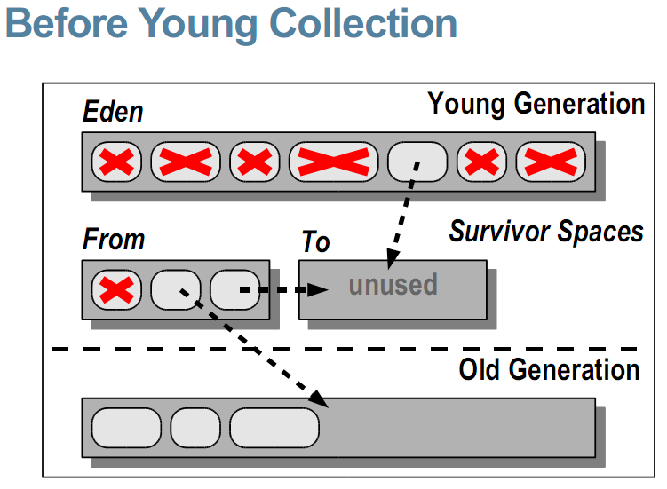
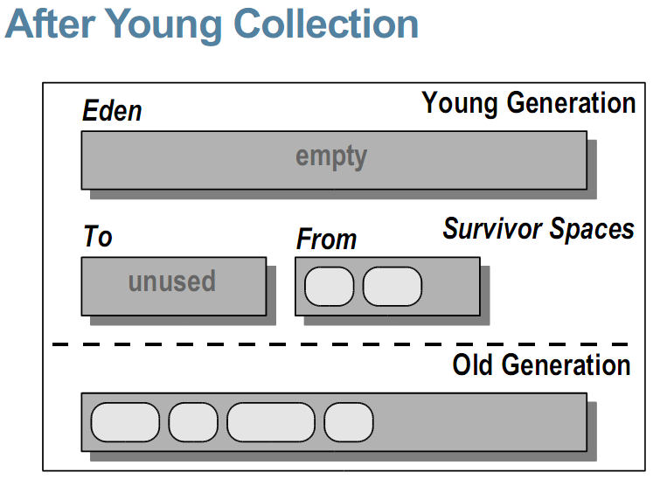
Generational Collection

Slide 16
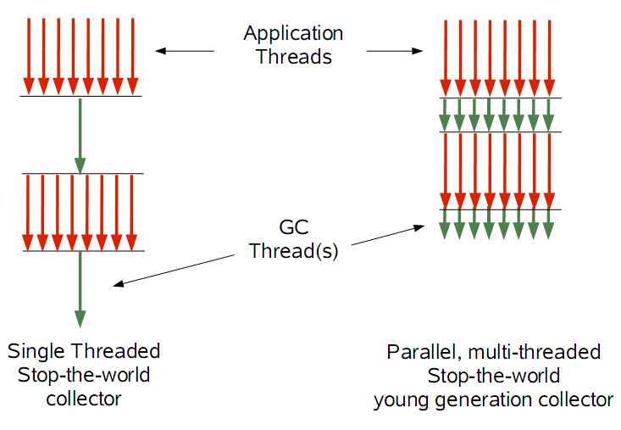
Parallel Young Generation Collector
Reason for parallel – (multiprocessor machine).

Slide 17
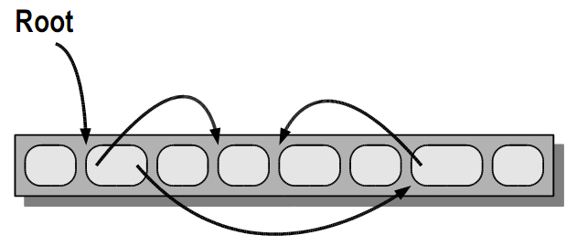
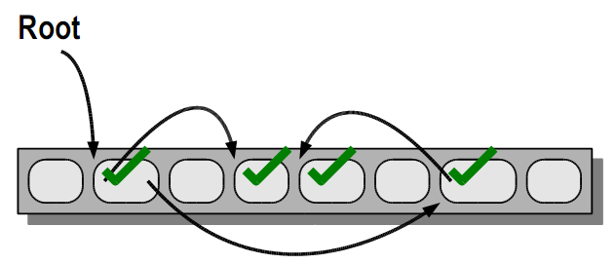
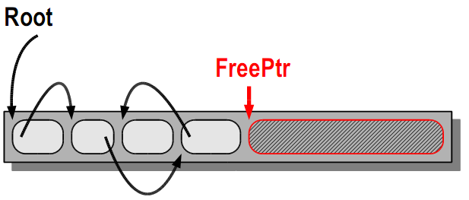
Mark-Compact Old Collector
Mark-Compact:
Initial
Mark-Compact:
Marking
Mark-Compact:
Compacting

Slide 18
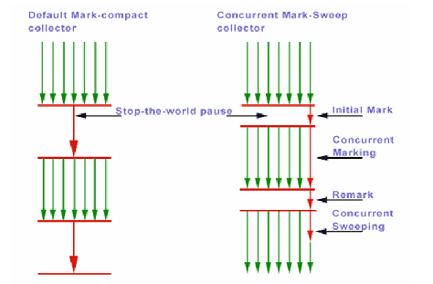
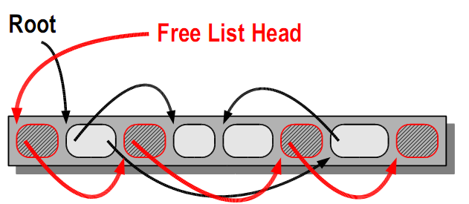
Mostly Concurrent Mark-Sweep Collector
Mark-Sweep:
Sweeping

Slide 19
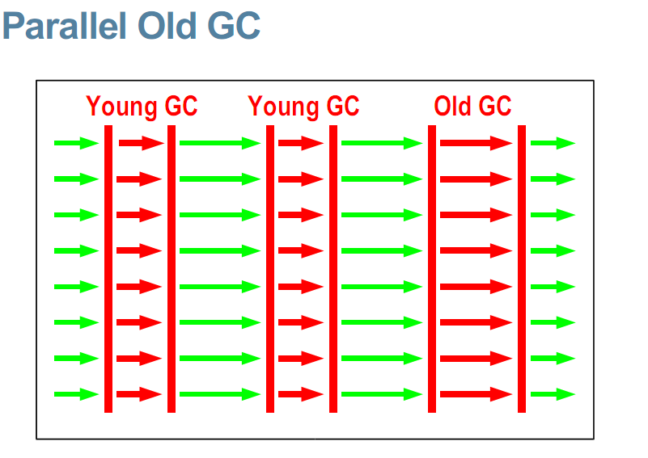
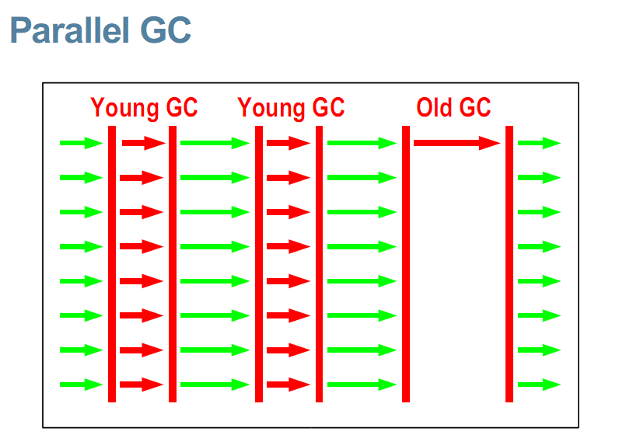
Parallel Old Generation Collector

Slide 20
Java HotSpot Compilers
Focus is on compilation techniques.
Problems with JIT… jit’s optimizations : less effective.
… java is dynamically safe.
…object allocation on heap.
… dynamic loading of classes + their optimizaton
+ rollback..

Slide 21
Hot Spot Detection. (80/20 rule).
for example, loop has an upper index value of 10,000, it's an immediate candidate for optimization.
5
Every future call :
Uses native code
1
Bytecode loading
HotSpot
Compiler
2
interpreter
4
profiler
3
Compiles
+
optimizes
optimized native code
Hardware

Slide 22
time spent in method = threshold set, becomes a candidate for optimization.
Java Hot Spot Client Compiler.
Java Hot Spot Server Compiler.
..both uses SSA (static single assignment) form.

Slide 23
Compiler Optimizations
Deep inlining.
Fast instanceof/checkfast.
Range check elimination.
Loop-unrolling.
Feedback-directed optimizations.
…Server VM uses extensive profiling.

Slide 24
Advanced Features of Java Hot Spot VM
Scalability.
…automatic self-sizing + adaptaion.
Reliability & Serviceability.
…JVM TI.
…Full Speed Debugging.
…HotSwap support.

Slide 25
Availability
Solaris Operating Environment for SPARC platforms.
Solaris Operating Environment for Intel platforms.
Linux Operating Systems: several versions of Red Hat Enterprise Linux, SuSE Linux .
Microsoft Windows .

Slide 26
Summary
optimal performance for Java applications.
separate compilers for client and server environments so that applications can be optimized according to their target deployment environments.
client applications start up faster
server applications can achieve better sustained performance over the long run .
Both solutions deliver an extremely reliable, secure, and maintainable environment to meet the demands of today's enterprise customers.

